Slide 1
Equation discovery system
Christina Pantopoli

Slide 2
Progress so far
With the use of a JAVA framework called JGAP I’ve managed to solve many examples of equations of the form y=f(x) and now trying to build a symbolic regression model to solve equations with multiple variables.
In the process of building an interface where the user inputs the number of evolutions, the name of the variables at this point I change these in the code.

Slide 3
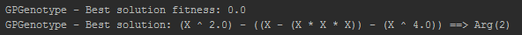
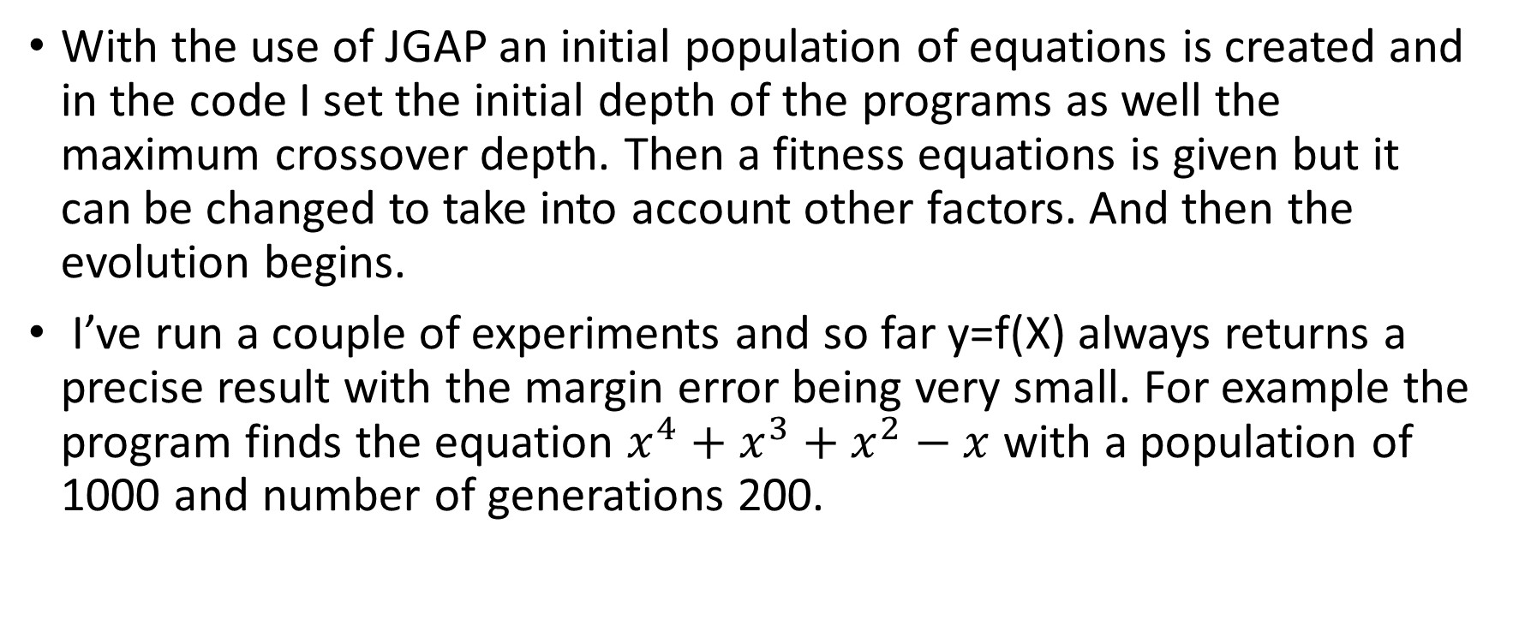
Progress so far 2
With the use of JGAP an initial population of equations is created and in the code I set the initial depth of the programs as well the maximum crossover depth. Then a fitness equations is given but it can be changed to take into account other factors. And then the evolution begins.
I’ve run a couple of experiments and so far y=f(X) always returns a precise result with the margin error being very small. For example the program finds the equation $x^{4}+x^{3}+x^{2}−x$ with a population of 1000 and number of generations 200.

